Slide 1

Submitted by,
Tanya Maheshwari,
Intern
Rapidcode Technologies Pvt. Ltd.

Slide 2
INDEX
OBJECTIVE
REQUIREMENT(s)
ABOUT PROJECT
FLOW CHART
PROJECT MANAGEMENT
SNAPSHOTS

Slide 3
OBJECTIVE
The main objective of “Quiz Contest” is to facilitate a user friendly environment for all users and reduces the manual effort. In past days quiz is conducted manually but in further resolution of the technology we are able to generate the score and pose the result automatically

Slide 4
REQUIREMENTS
USER REQUIREMENTS’
SYSTEM REQUIREMENTS’

Slide 5
USER REQUIREMENTS
BASIC UNDERSTANDING OF UNIX ENVIORNMENT TO COMPILE THE CODE SUCESSFULLY.

Slide 6
SYSTEM REQUIREMENTS
SOFTWARE REQUIREMENT
FRONT END- C
Operating System – UNIX/LINUX

Slide 7
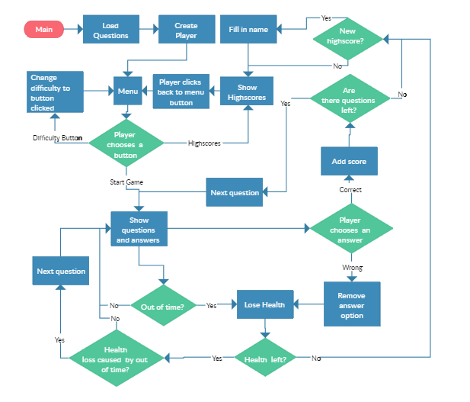
Flow chart

Slide 8
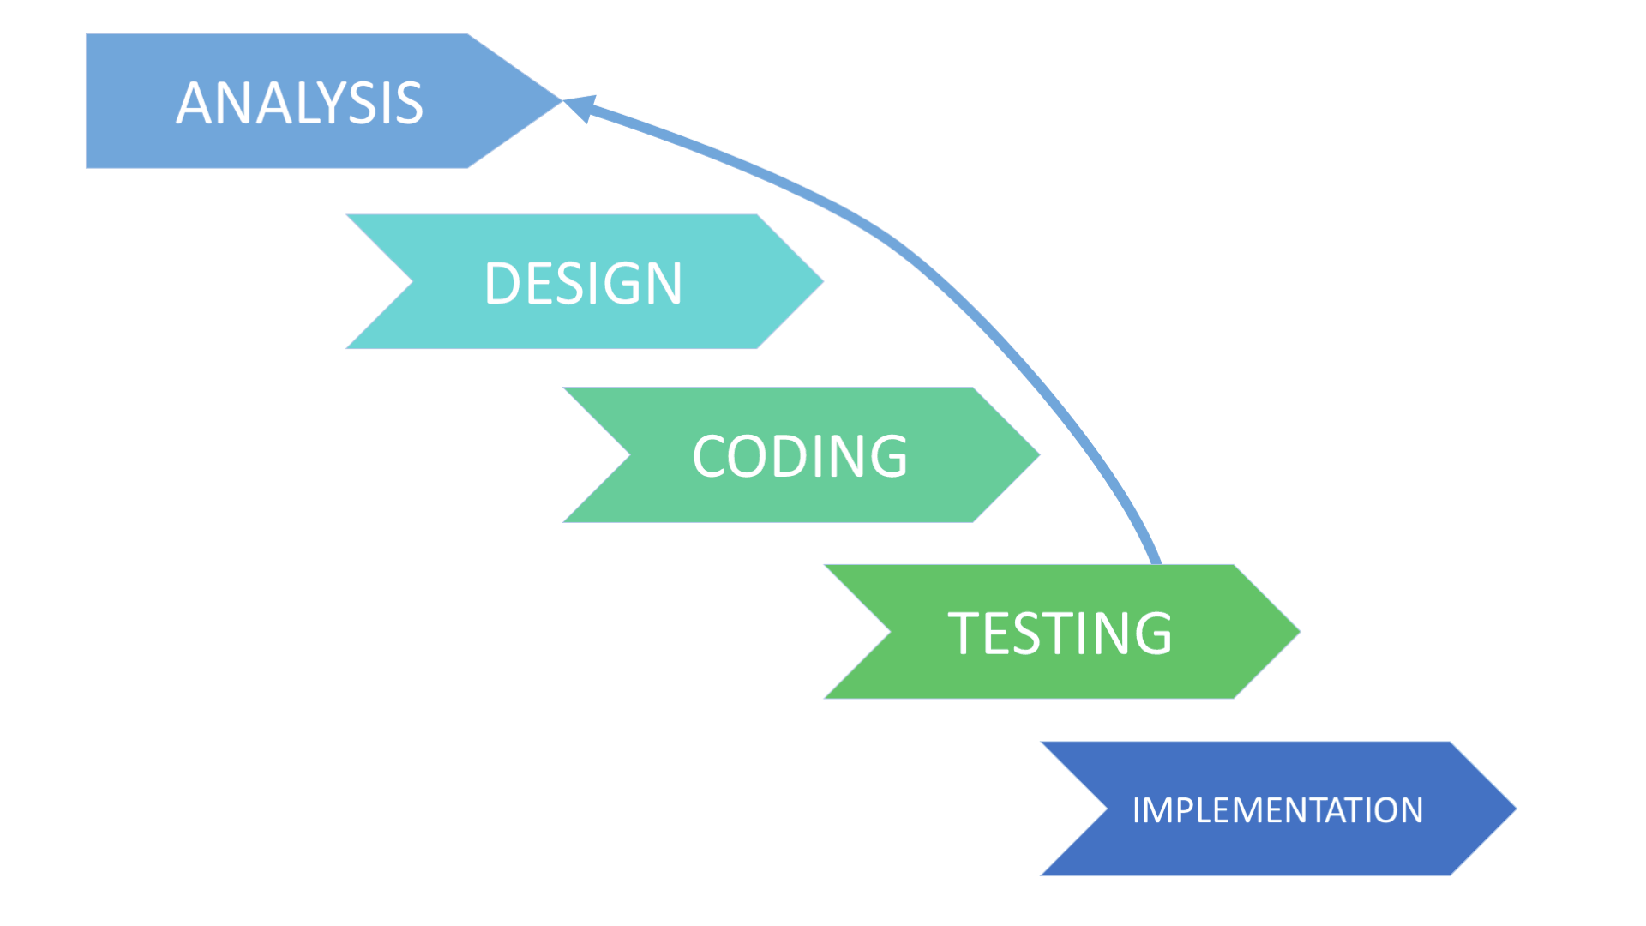
PROJECT MANAGEMENT

Slide 9
ABOUT PROJECT
Quiz contest is an application that has general questions related to general knowledge.
It has multiple choice questions and it calculates score of each correct answer.
It is good for students of every age group
It helps in increasing knowledge about world , sports , computer , etc.
Here you just need to register your name and do not worry for the past scores.
. Before starting the game , rules and regulations are displayed that includes number of questions , scoring methods.

Slide 10
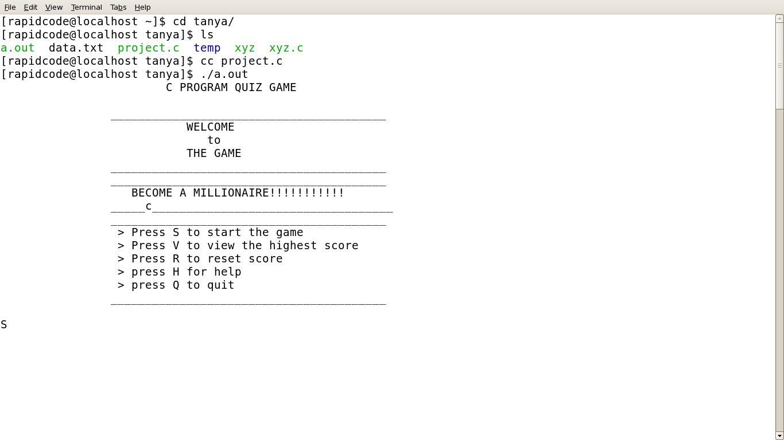
SNAPSHOTS :

Slide 11
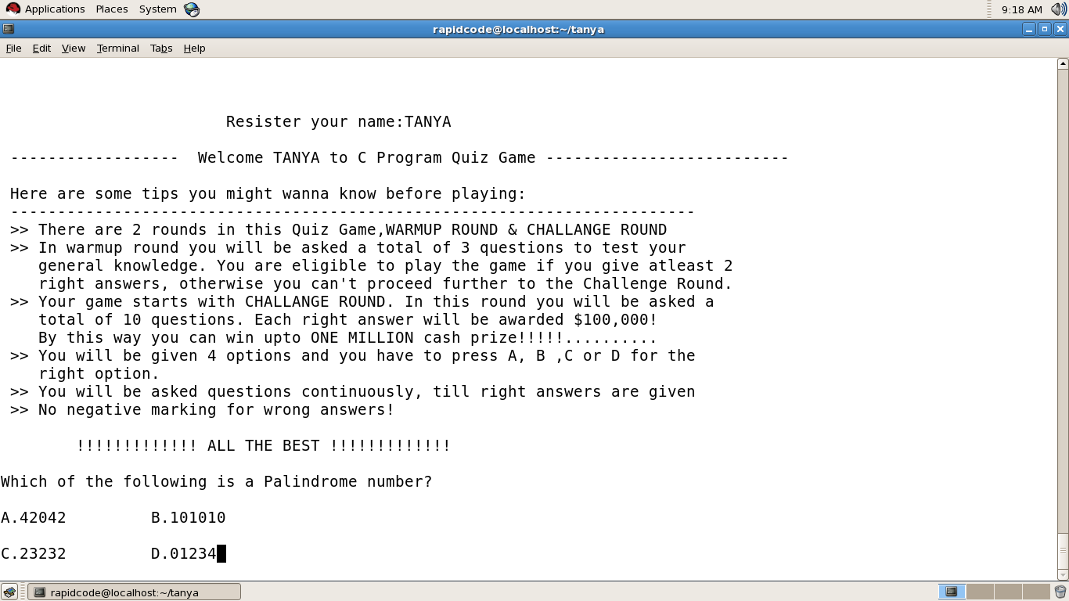
:
REGISTERING NAME PAGE:

Slide 12
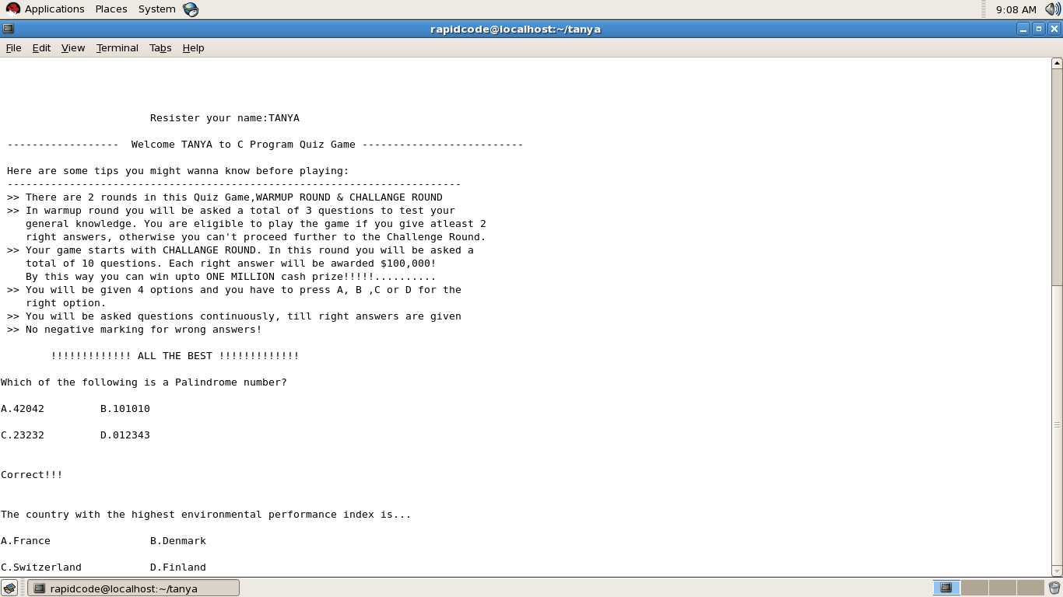
SAMPLE QUESTION :

Slide 13
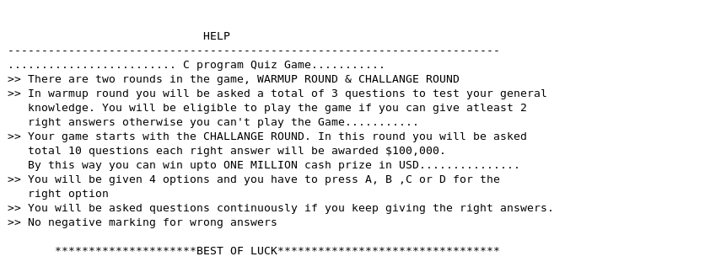
HELP MENU:

Slide 14
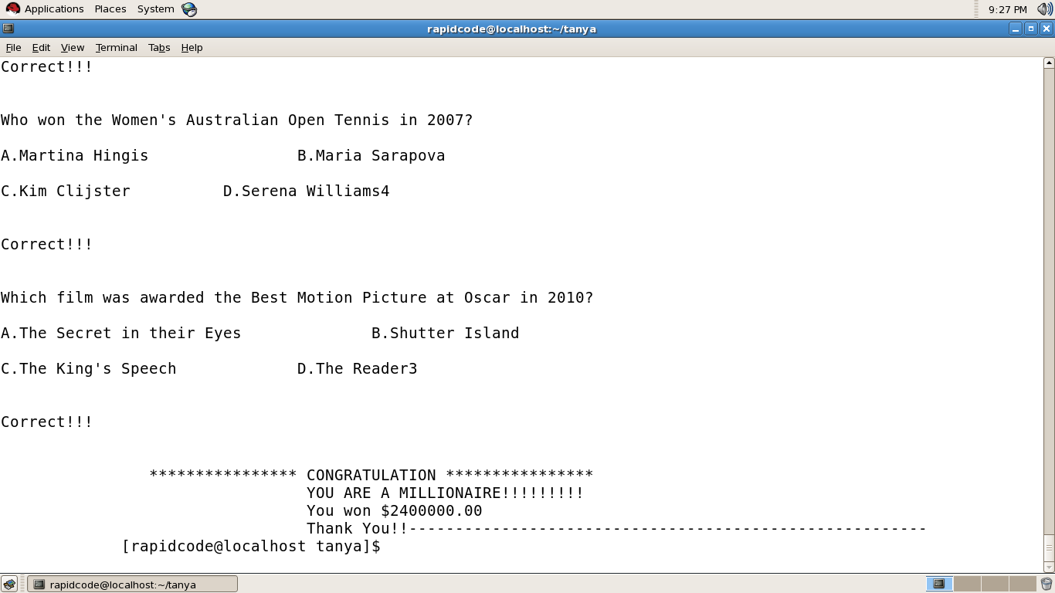
FINAL WINNER, THE MILLIONAIRE:

Slide 15
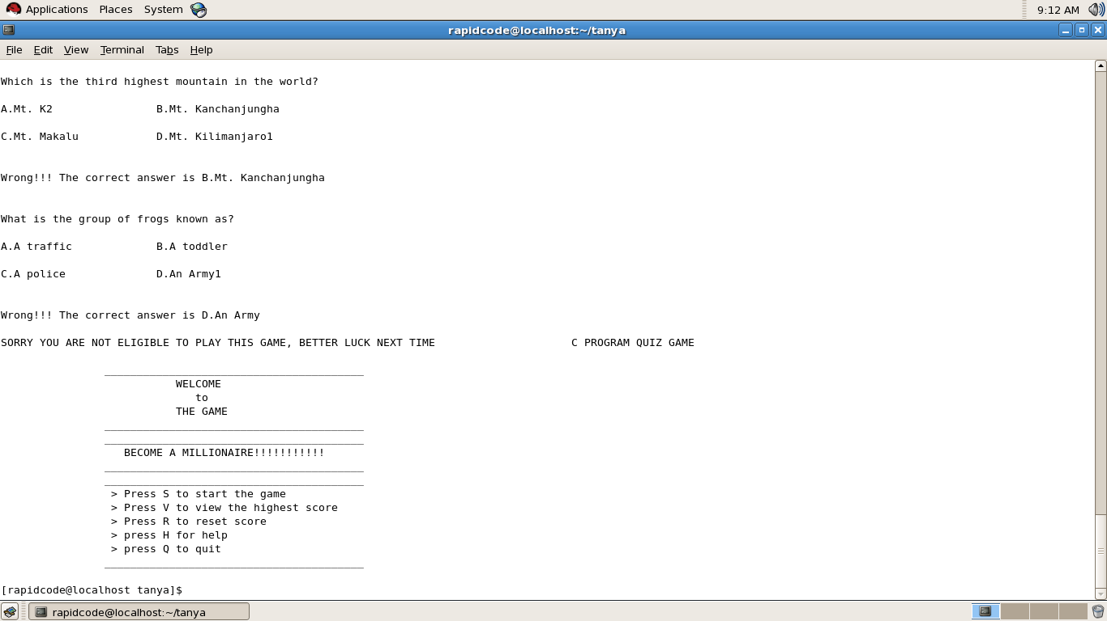
TERMINATION CONDITION

Slide 16


THANK YOU!

